Slide 1
3D Modeling Process for Energy Can
This process covers the creation of a 3D energy can model using various tools and techniques in 3D software.

Slide 2
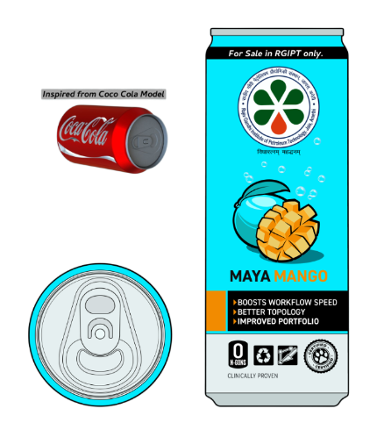
Importing the Blueprint Image
Start by importing the blueprint as an image plane for reference in your 3D workspace.

Slide 3
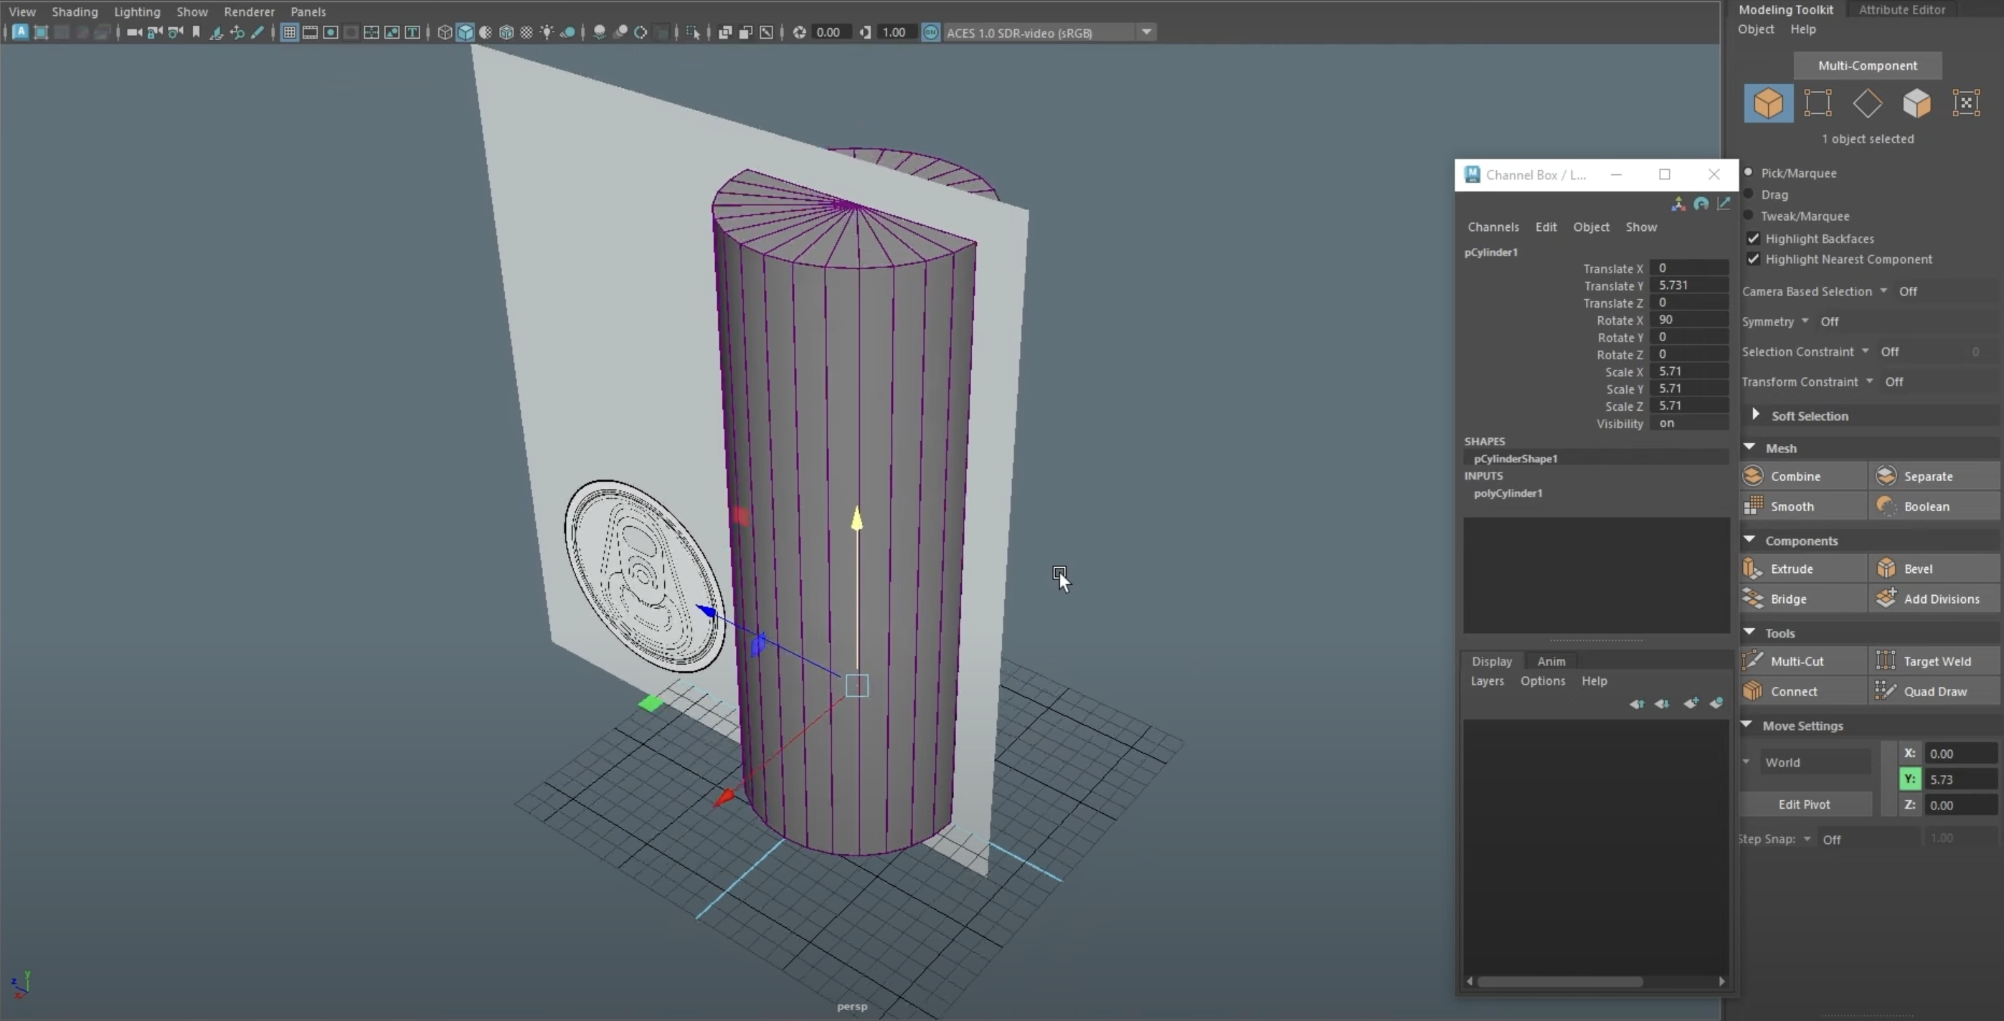
Rough Scaling Setup
Use a cylinder to set up rough scaling within the grid, adjusting it according to the blueprint.

Slide 4
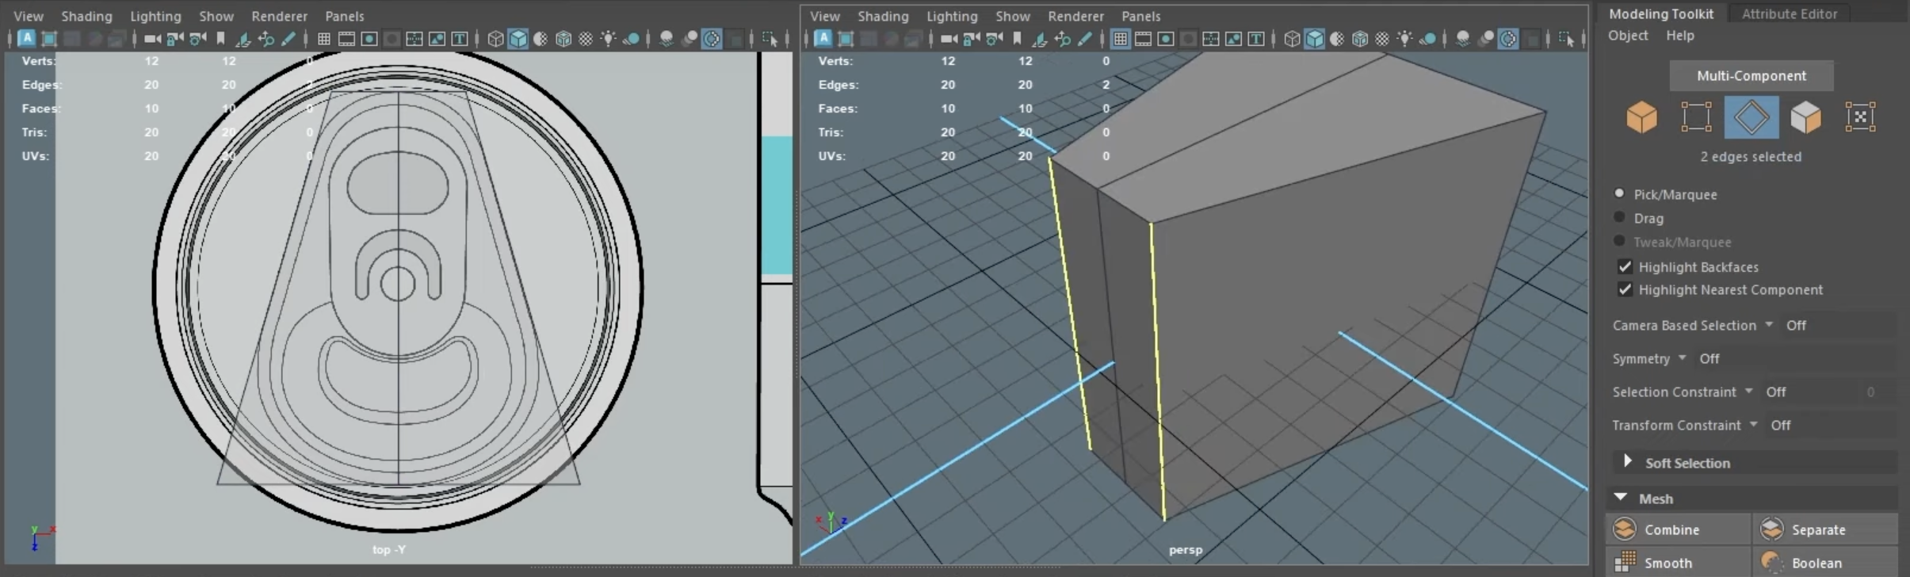
Adjusting Top View with Cube Creation
Import the blueprint again and create a cube to capture the height and curvature.

Slide 5
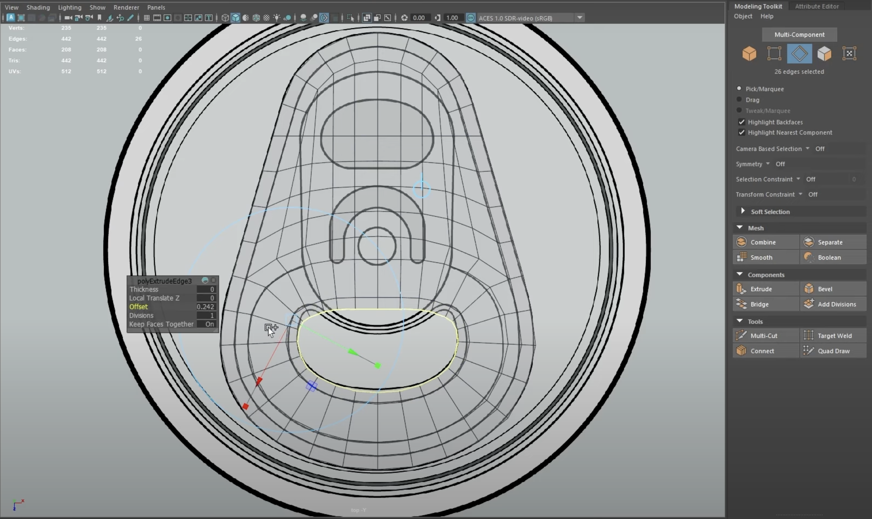
Using Bevel for Smooth Curvature
Apply the bevel command to create smooth curves on both the top and bottom parts.

Slide 6
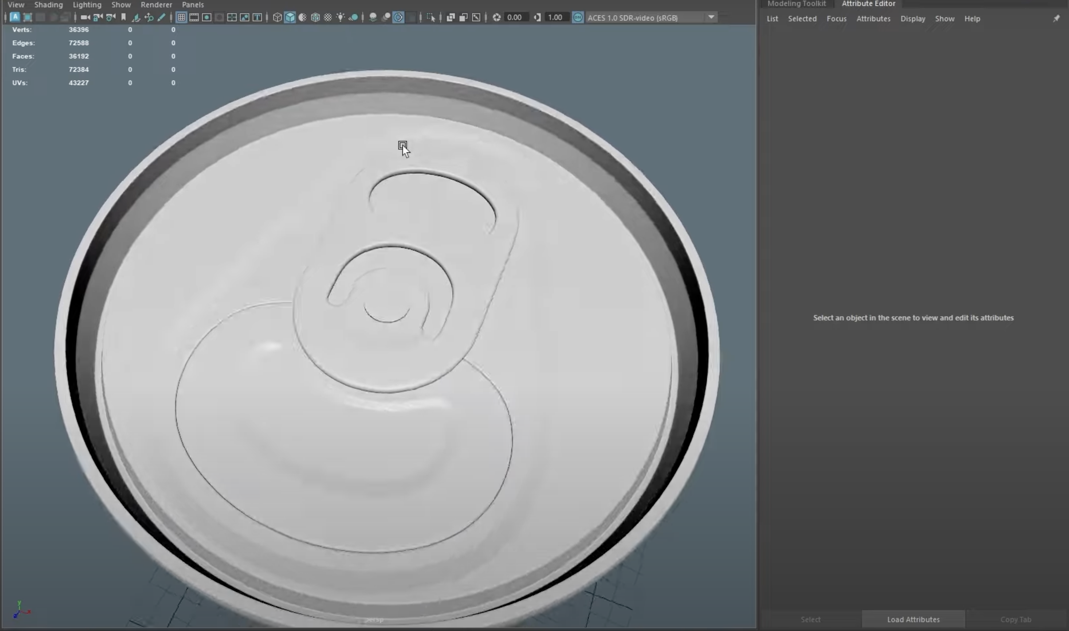
Finalizing Shape and Mesh Combination
Complete the shape by combining the mesh and deleting unnecessary faces.

Slide 7
Creating the Cap and Extruding
Create the cap of the can by extruding the selected faces and adjusting the curvature.

Slide 8
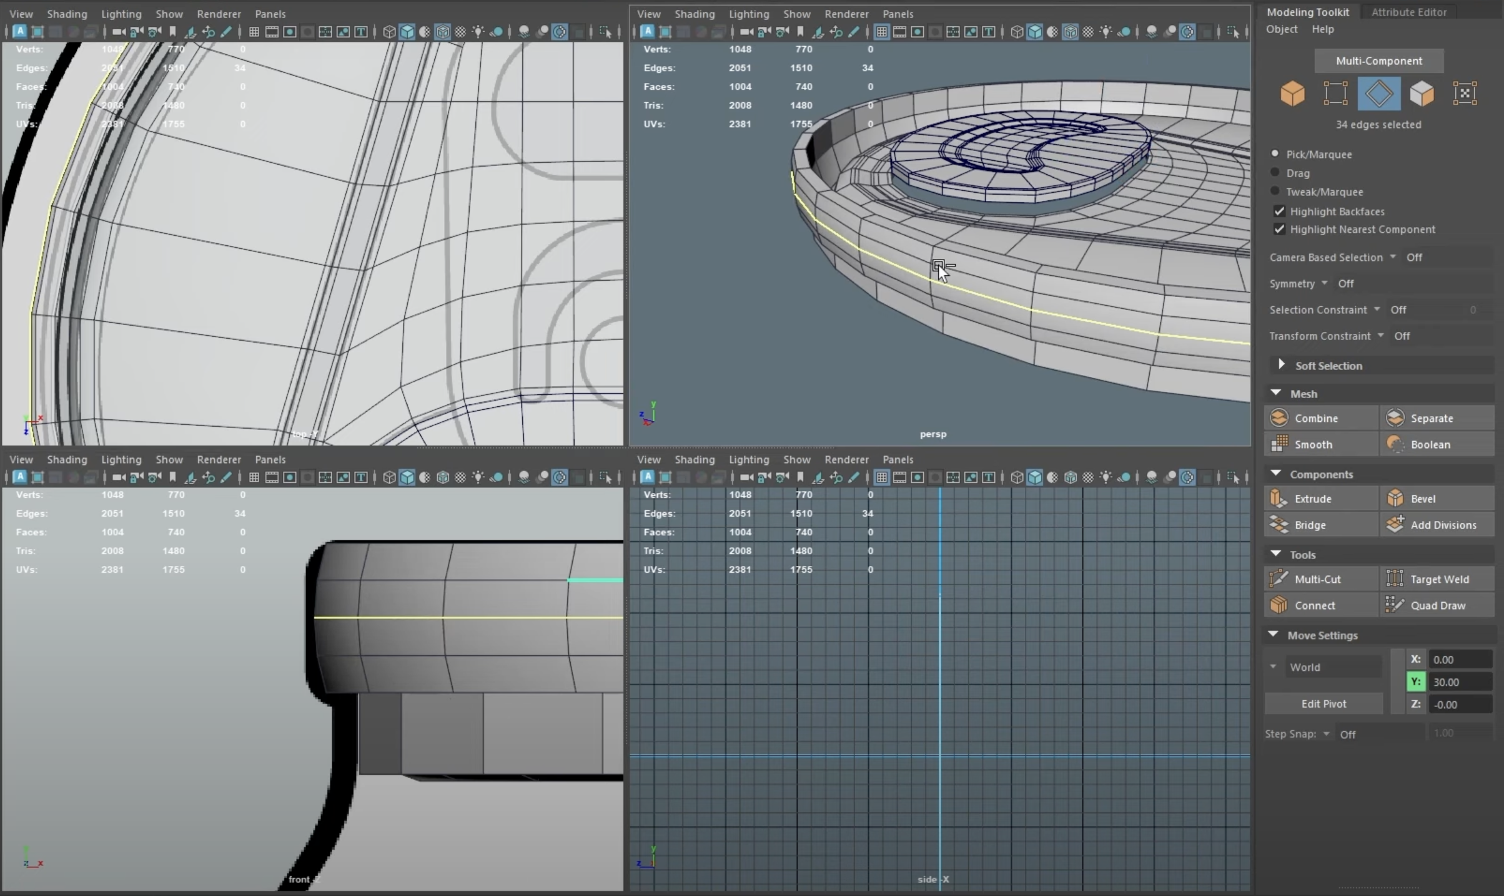
Shaping the Top and Finalizing Curves
Refine the top by using the extrude tool and adjusting the shape to match the reference.

Slide 9
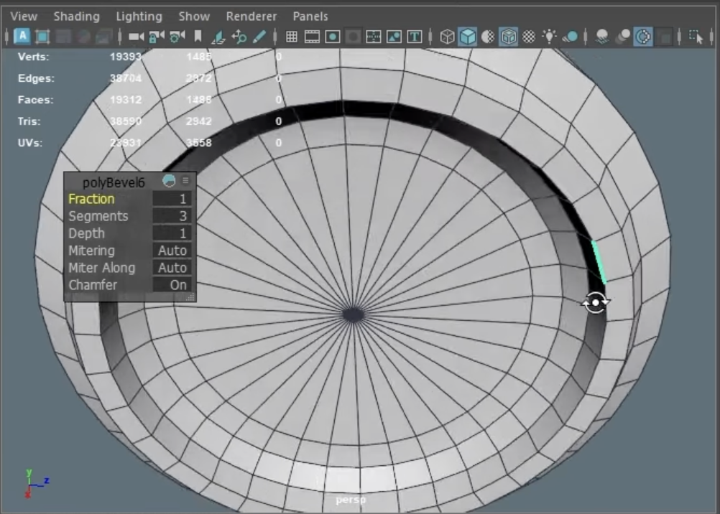
Designing the Bottom with Extrusion
Create the bottom of the can by extruding and scaling to form the lip and thickness.

Slide 10
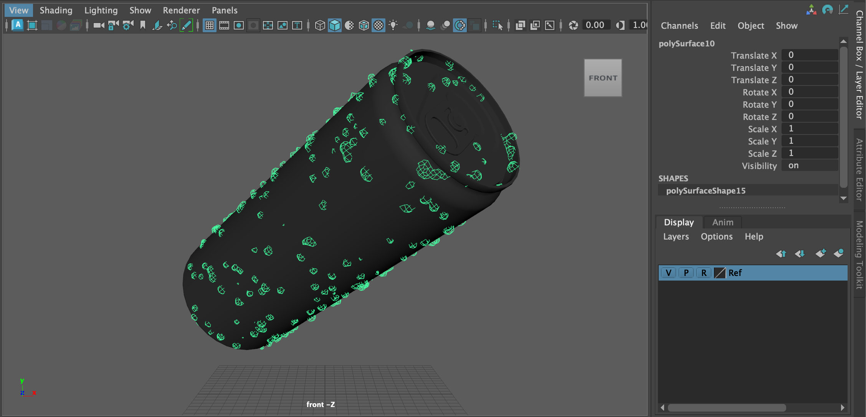
Final Check and Animation Setup
Review the model for any visible issues, then prepare for animation and effects.

Slide 11
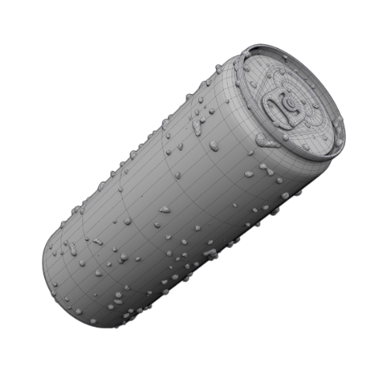
thank you!!!
Mannem shamili
23ec3027@rgipt.ac.in

